Slide 1

Maximum Flows by
Incremental Breadth-First Search
Andrew V. Goldberg, Sagi Hed, Haim Kaplan
Robert E. Tarjan, and Renato F. Werneck
Zi Yun Lin

Slide 2
Introduction

Slide 3
Boykov-Kolmogorov (BK) algorithm
No known polynomial time bound
Perform poorly in practice
Incremental Breadth-First Search (IBFS)
Combine ideas from BK with shortest augmenting path algorithm
Theoretically runs in polynomial time
3

Slide 4
Notations

Slide 5
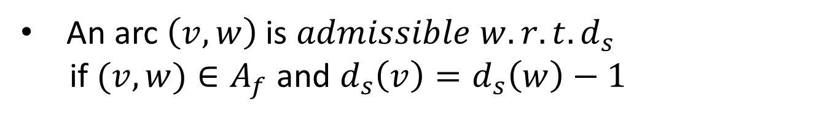
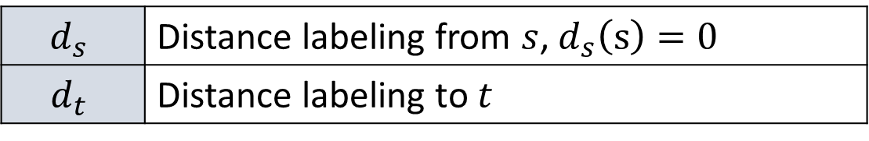
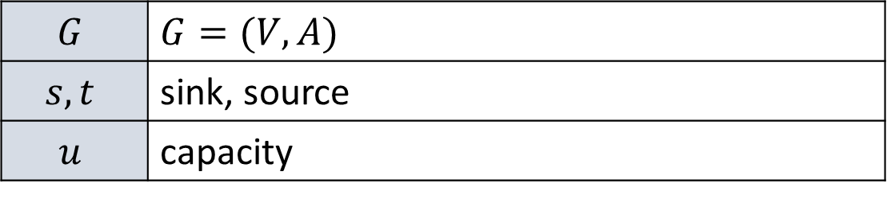
Sets
$$G$$ | $$G=(V,A)$$
$$s, t$$ | sink, source
$$u$$ | capacity
$$d_{s}$$ | Distance labeling from $s$, $d_{s}\left(s\right)=0$
$$d_{t}$$ | Distance labeling to $t$
Given a flow $f$, for all $(v,w)∈A_{f}$, $d_{s}\left(w\right)≤d_{s}\left(v\right)+1$
An arc $\left(v,w\right)$ is $admissible w.r.t. d_{s}$
if $(v,w)∈A_{f}$ and $d_{s}\left(v\right)=d_{s}\left(w\right)−1$
5

Slide 6

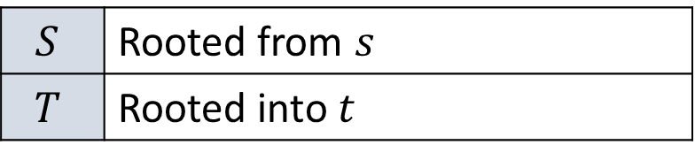
Sets
Two trees of residual arcs
$$S$$ | Rooted from $s$
$$T$$ | Rooted into $t$
At each step, a vertex is in $S$, in $T$, or $free$
Each tree has active and internal vertices
6

Slide 7
Incremental Breadth-First Search (IBFS)

Slide 8
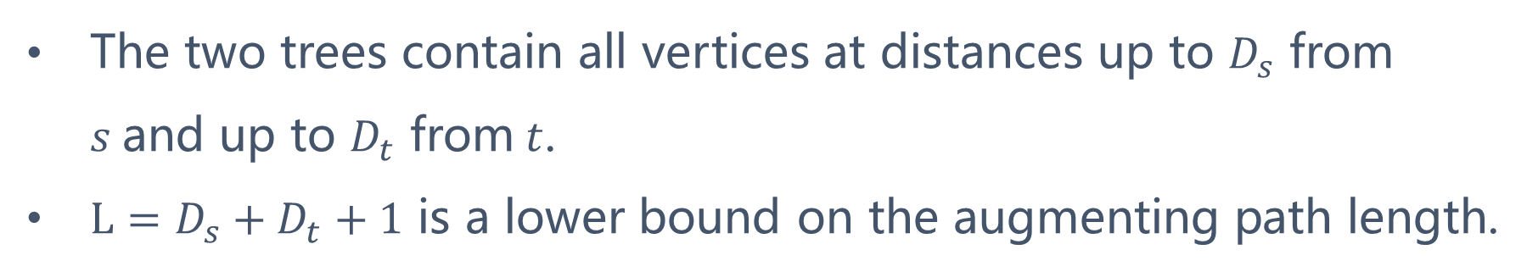
The two trees contain all vertices at distances up to $D_{s}$ from $s$and up to $D_{t}$ from $t$.
$L=D_{s}+D_{t}+1$ is a lower bound on the augmenting path length.
8

Slide 9

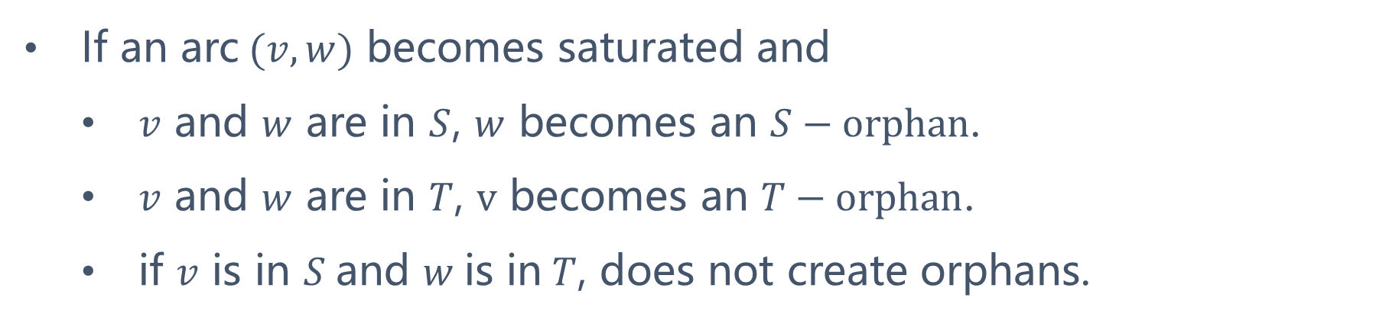
If an arc $(v,w)$ becomes saturated and
$v$ and $w$ are in $S$, $w$ becomes an $S−orphan$.
$v$ and $w$ are in $T$, $v$ becomes an $T−orphan$.
if $v$ is in $S$and $w$is in $T$, does not create orphans.
A vertex can be an
$S−vertex, T−vertex, S−orphan, T−orphan$ or $N−vertex$
9

Slide 10
Three stages:
Growth
Augmentation
Adoption
10

Slide 11
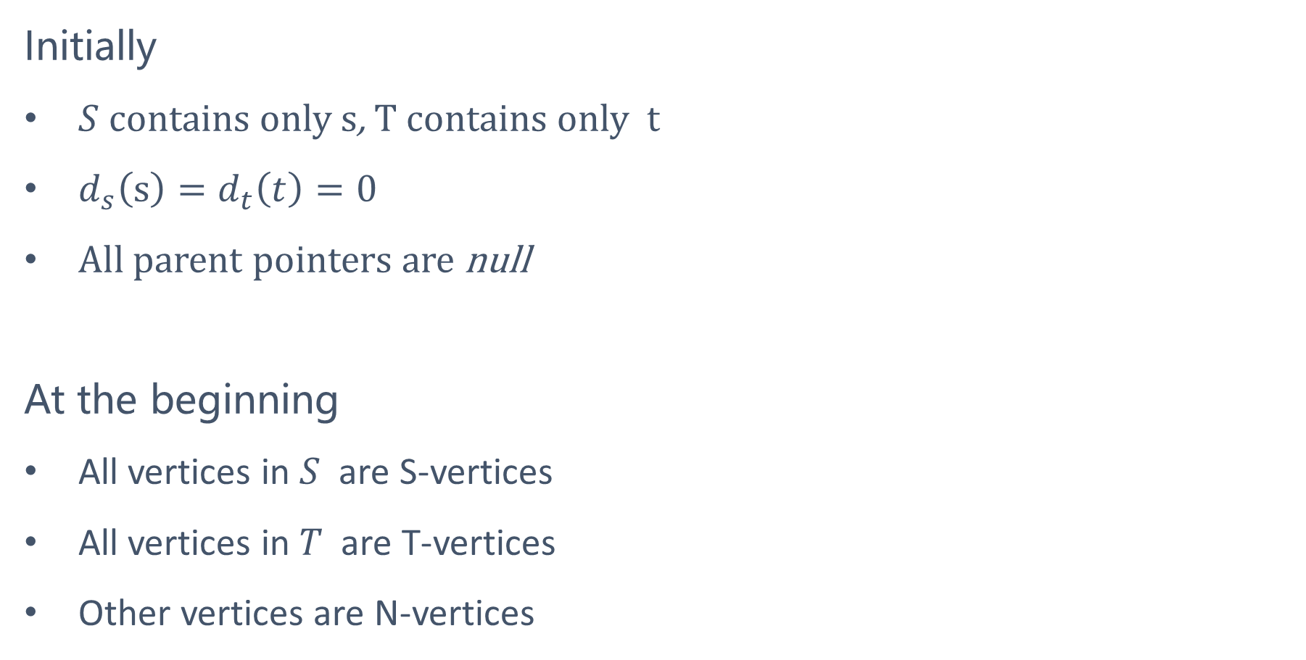
Initially
$S$ contains only $s$, $T$ contains only $t$
$d_{s}\left(s\right)=d_{t}\left(t\right)=0$
All parent pointers are null
At the beginning
All vertices in $S$ are S-vertices
All vertices in $T$ are T-vertices
Other vertices are N-vertices
11

Slide 12
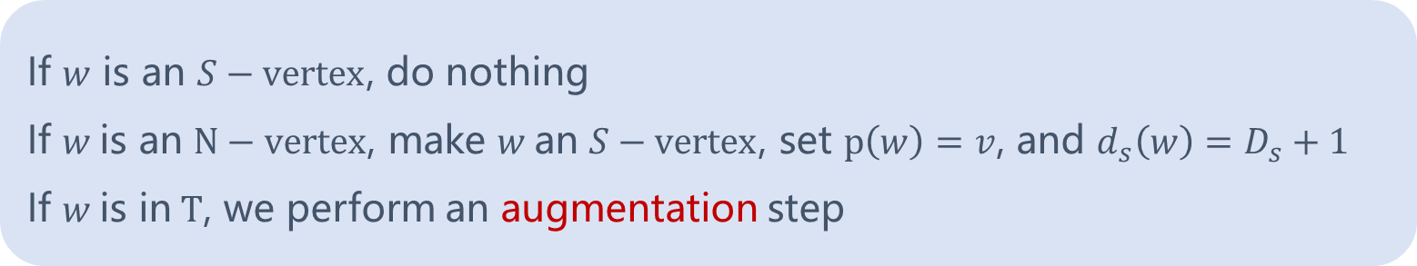
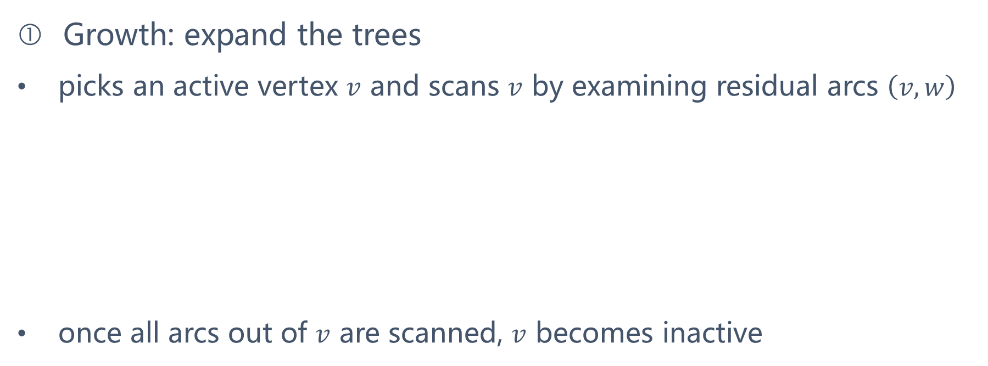
Growth: expand the trees
picks an active vertex $v$ and scans $v$ by examining residual arcs $\left(v,w\right)$
once all arcs out of $v$ are scanned, $v$ becomes inactive
If $w$ is an $S−vertex$, do nothing
If $w$is an $N−vertex$, make $w$an $S−vertex$, set $p\left(w\right)=v$, and $d_{s}\left(w\right)=D_{s}+1$
If $w$is in $T$, we perform an augmentation step
12

Slide 13
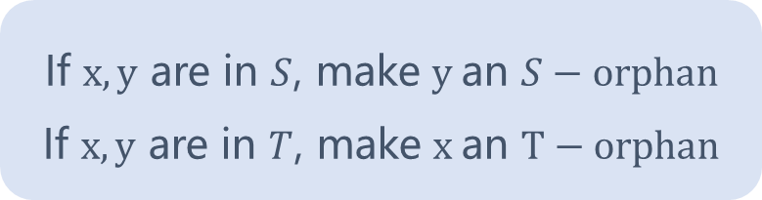
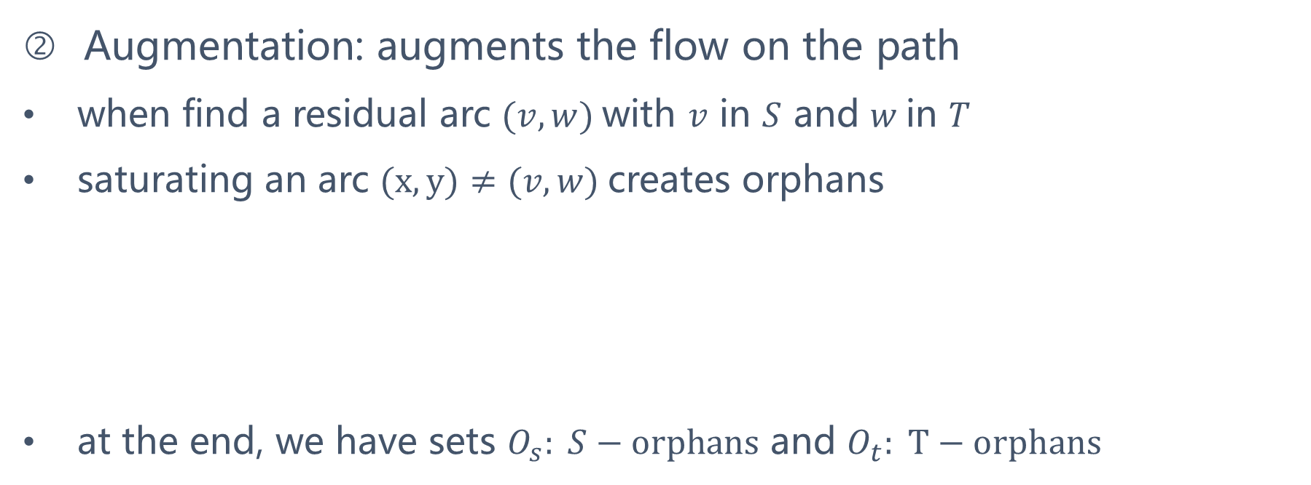
Augmentation: augments the flow on the path
when find a residual arc $(v,w)$with $v$ in $S$ and $w$in $T$
saturating an arc $(x,y)≠(v,w)$creates orphans
at the end, we have sets $O_{s}: S−orphans$ and $O_{t}: T−orphans$
If $x, y$ are in $S$, make $y$an $S−orphan$
If $x, y$ are in $T$, make $x$an $T−orphan$
13

Slide 14
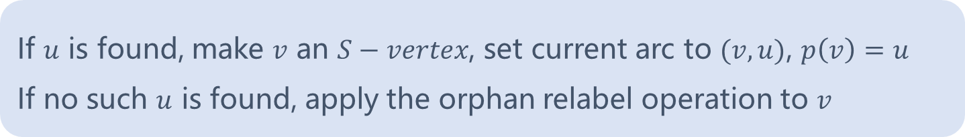
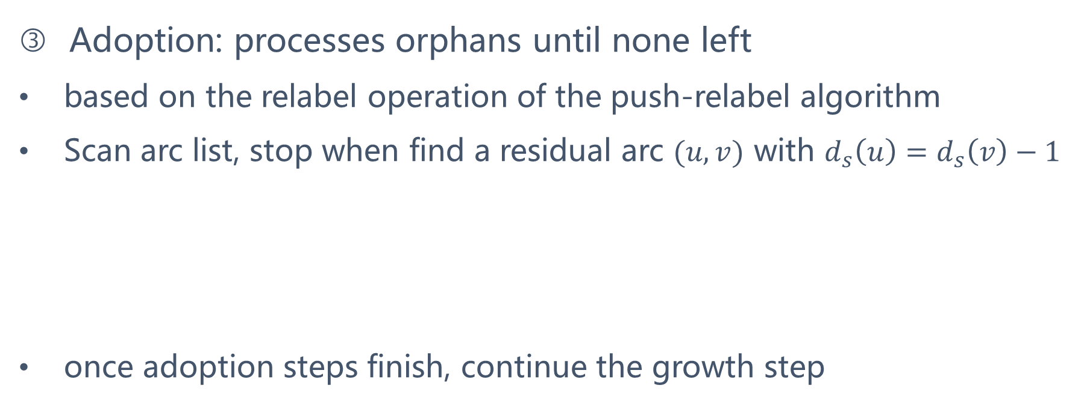
Adoption: processes orphans until none left
based on the relabel operation of the push-relabel algorithm
Scan arc list, stop when find a residual arc $(u,v)$ with $d_{s}\left(u\right)=d_{s}\left(v\right)−1$
once adoption steps finish, continue the growth step
If $u$ is found, make $v$ an $S−vertex$, set current arc to $(v,u)$, $p\left(v\right)=u$
If no such $u$ is found, apply the orphan relabel operation to $v$
14

Slide 15
Running Time

Slide 16
Three types of operations:
Growth steps without augmentations
Adoption steps
Growth steps with augmentations
16

Slide 17
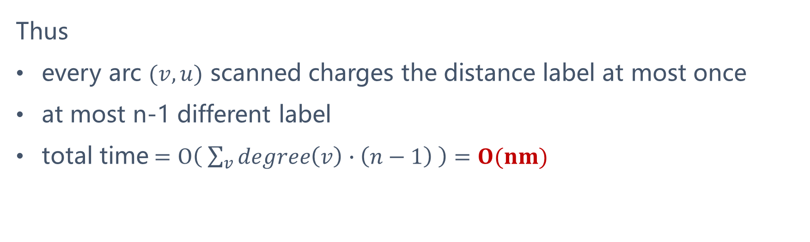
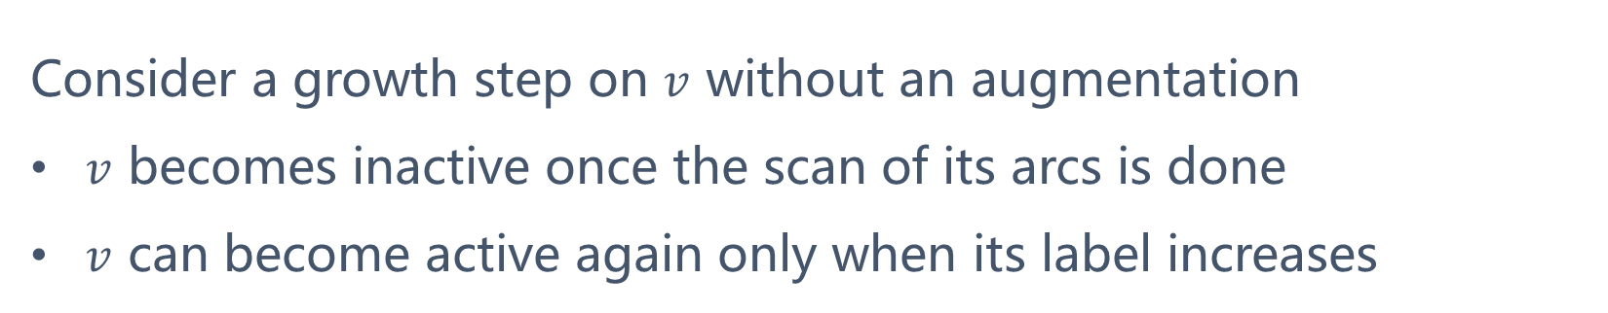
Growth steps without augmentations
Consider a growth step on $v$ without an augmentation
$v$ becomes inactive once the scan of its arcs is done
$v$ can become active again only when its label increases
Thus
every arc $(v,u)$ scanned charges the distance label at most once
at most n-1 different label
total time $=O\left( \sum_{v}{degree\left(v\right)∙\left(n−1\right) }\right)=O(nm)$
17

Slide 18
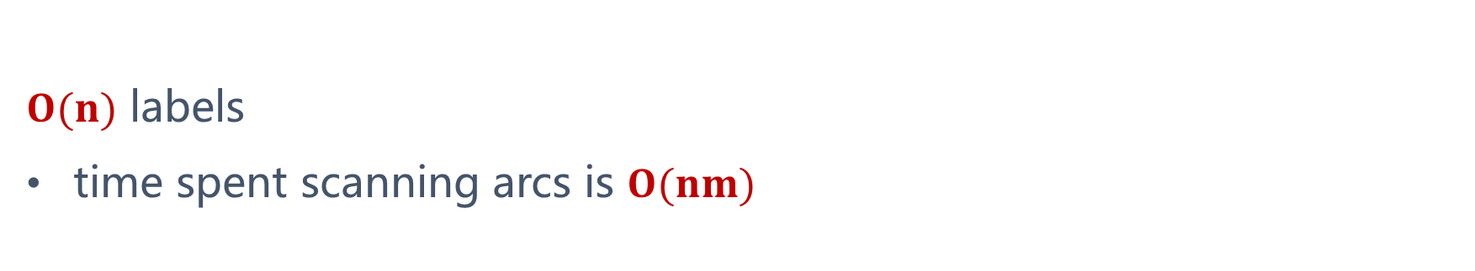
Adoption steps
Every arc charges each label at most twice
once in an orphan scan
once in an orphan relabel
$O(n)$ labels
time spent scanning arcs is $O(nm)$
18

Slide 19
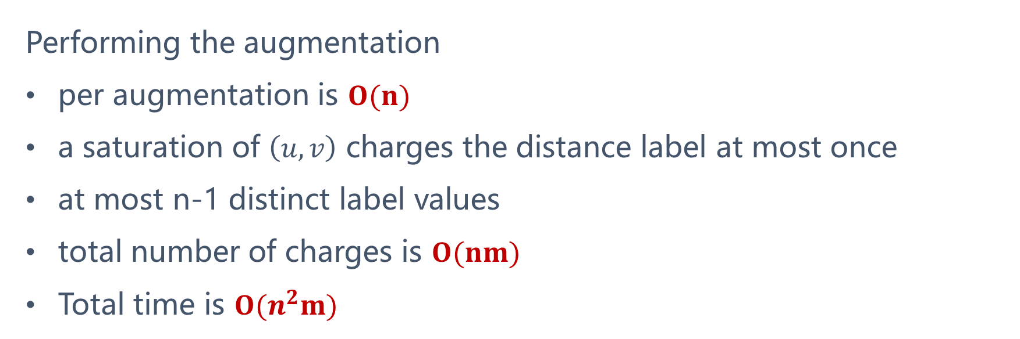

Growth steps with augmentations
Scanninng arcs of $v$ to find the arc to $T$: $O(nm)$
an arc is scanned only once per activation of $v$
Performing the augmentation
per augmentation is $O(n)$
a saturation of $\left(u,v\right)$ charges the distance label at most once
at most n-1 distinct label values
total number of charges is $O(nm)$
Total time is $O(n^{2}m)$
19

Slide 20
Thank You

